Slide 1
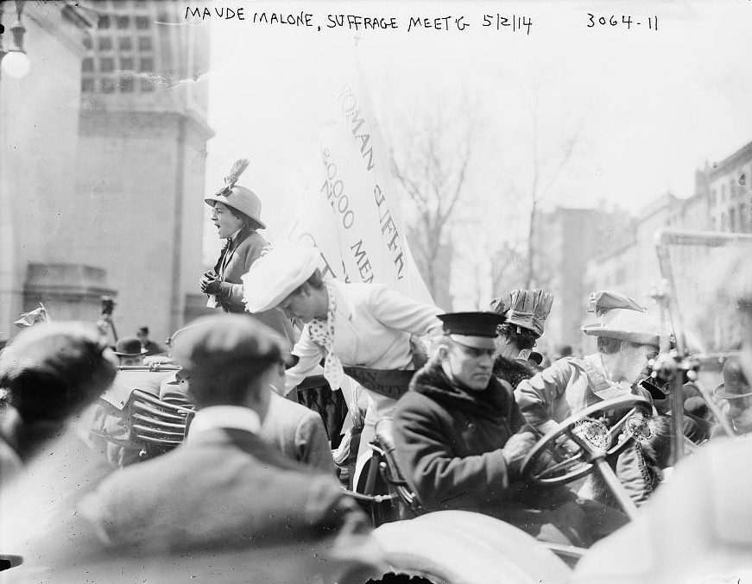
Maud Malone: Creating a role for librarians in Reacting
Source: Wikipedia (Bain News Service, publisher)

Slide 2
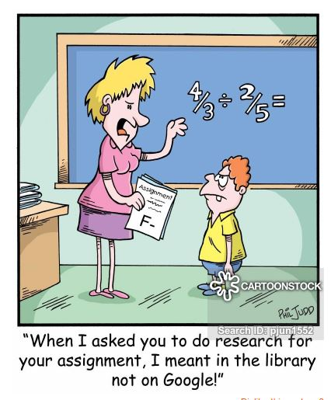
Students often say, “do research” but that means putting general words or phrases into Google.

Slide 3
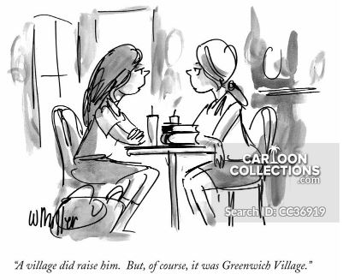
Introduced Greenwich Village 1913.
Students debated with great energy and enthusiasm, cared about their roles, and about the outcome of the game.

Slide 4
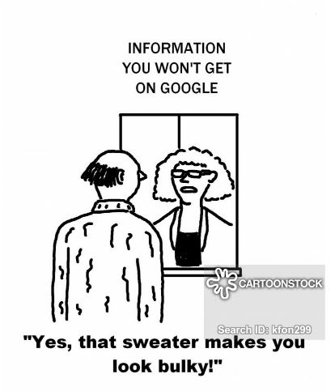
Weakness: Research
No idea how to find information beyond online searching.
Didn’t really know what a librarian did.
Didn’t understand how to ask or answer an historical question.

Slide 5
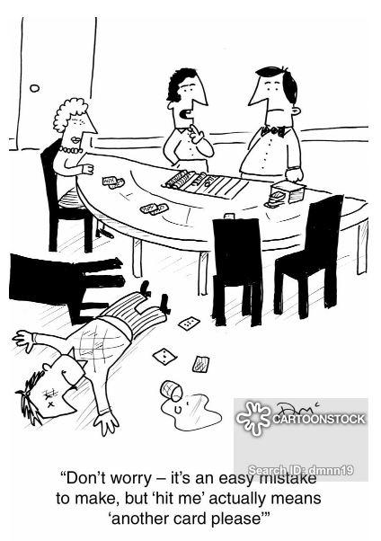
Reacting has all the hallmarks of effective pedagogy.
It’s intensely engaging, immersive, experiential and, most importantly, scholarly in nature.

Slide 6
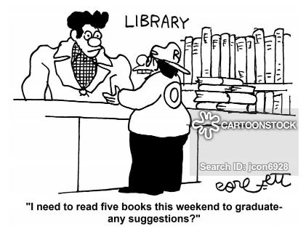
Typical role of librarian: One-shot wonder
Ideal role of librarian: Embedded teaching partner

Slide 7
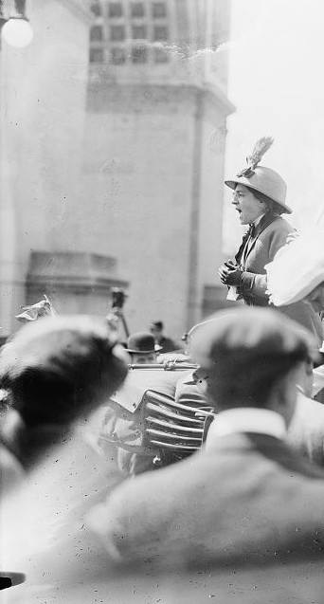
Maud Malone: Outspoken advocate for women’s and worker’s rights 1. Commander of the Flying Squad of Street Suffragettes. 2. A founder of the Library Employees’ Union of Greater New York in 1917.
Source: Wikipedia (Bain News Service, publisher)

Slide 8
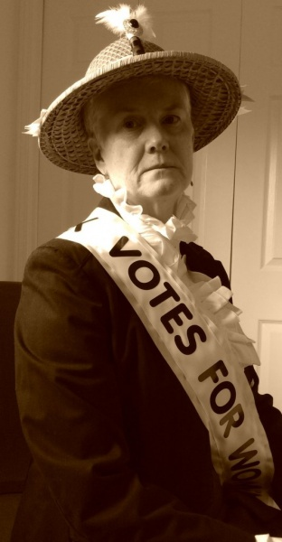
Model role playing & research processes
Asks questions
Encourages debate
Consults with factions
Demonstrates how to find primary & secondary sources
Tools
In-class search workshops
Online course guide
Costume lending library
One-to-one consultations for PIPS

Slide 9
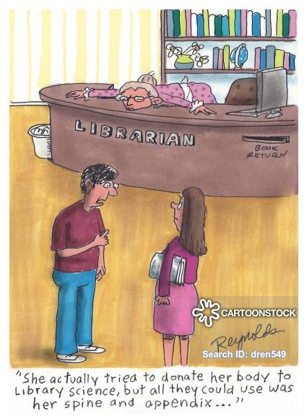
Student feedback on Maud
"She provided opinions in class about the suffrage and labour movements and gave the students another character to work off of in the context of the game. She provided us with resources in the school library to help us further our research and got us interested in our character's stories beyond the textbook.”
Emma Wiechers, October 2019

Slide 10
Research is the game:
Maud makes this visible
by being the game.

